Slide 1

Prompting for Data, ML & Analytics
Master the art of using AI prompts to extract insights, clean data, and accelerate your machine learning workflow. This module teaches practical techniques for data professionals.

Slide 2


DATA EXTRACTION
From Chaos to Structure
The Challenge
Real-world data arrives messy: emails, PDFs, logs, screenshots. Extracting structured information manually is time-consuming and error-prone.
The Solution
Strategic prompts transform unstructured text into clean, structured formats like JSON or CSV. You define the fields, the AI extracts the data.

Slide 3
Data Extraction in Action
Basic Extraction
Production-Level
Key Techniques
Simple prompt: "Extract Name, Email, Skills as JSON from this text." Perfect for quick parsing of resumes or contact forms.
Advanced prompt includes role definition, strict formatting rules, null handling, and field validation. Essential for enterprise applications.
Specify exact output format
Handle missing fields gracefully
Define data types clearly
Request validation logic
Prompt: "You are a data extraction assistant. Extract
structured information strictly in JSON format. If any
field is missing, return null.
Fields: Name, Email, Phone, Skills, Experience
Text: [Your unstructured data here]"

Slide 4
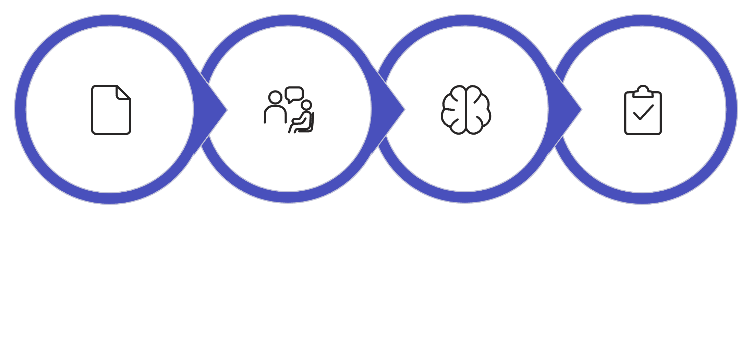

CSV Analysis & Insights
What to Request
Summary statistics and distributions
Trend identification across time periods
Performance comparisons by segment
Anomaly and outlier detection
Strategic business recommendations
Upload CSV
Enter Prompt
AI Insights
Review Tips
Pro tip: Frame prompts as "You are a senior analyst presenting to stakeholders" for business-focused insights rather than technical jargon.
Instead of manual spreadsheet analysis, strategic prompts unlock instant insights from your datasets.

Slide 5
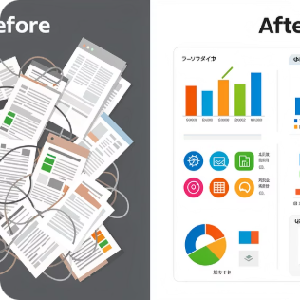

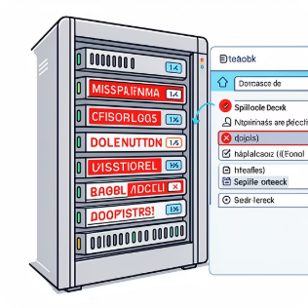
DATA CLEANING
Data Normalization Prompts
Standardize Formats
Remove Duplicates
Fix Inconsistencies
Identify and eliminate duplicate entries while preserving data integrity and maintaining referential relationships.
Correct spelling variations, handle mixed formats, and enforce schema validation rules automatically.
Convert inconsistent date formats, currency symbols, and text casing into uniform standards across your entire dataset.

Slide 6
Exploratory Data Analysis with AI
Accelerate your EDA process by prompting for comprehensive statistical analysis, pattern detection, and visualization recommendations.
Basic EDA Prompt
Why This Works
Request missing values analysis, distribution summaries, correlation insights, outlier detection, and suggested visualizations.
Role-based prompting shifts the AI's focus from academic analysis to business impact. You get insights that drive decisions, not just statistical summaries.
Advanced EDA Prompt
The key is specifying your audience and desired outcome in the prompt structure.
"Act as a senior data scientist preparing for stakeholder presentation. Focus on business insights, not just technical stats. Highlight actionable insights."

Slide 7



MACHINE LEARNING
ML Model Selection & Debugging
Describe Problem
Request Recommendations
Debug Issues
Dataset size, features, target variable type, business constraints
Suitable algorithms, pros/cons, evaluation metrics
Explain overfitting, data leakage, bias-variance tradeoff
"My accuracy is 98% but validation accuracy is 60%. Explain possible reasons and how to fix it."
This single prompt can teach you more about model evaluation than hours of documentation reading. The AI explains overfitting causes and provides actionable solutions.

Slide 8
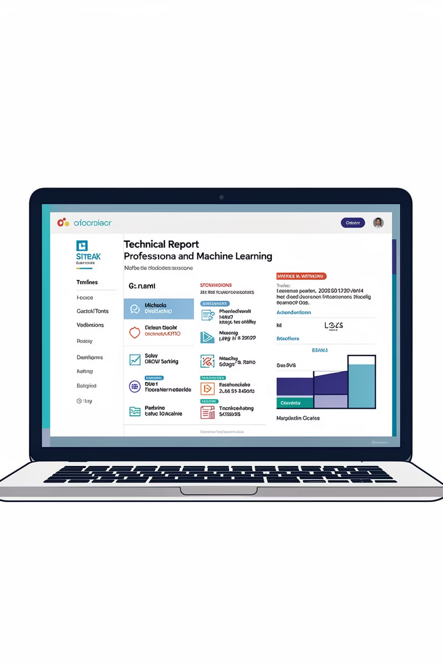
Automated ML Report Generation
Generate comprehensive project documentation including introduction, methodology, results, and conclusions. Perfect for internship reports, final year projects, or stakeholder presentations.
01
02
Provide Project Context
Specify Report Structure
Title, dataset source, algorithms used, performance metrics
Required sections: problem statement, preprocessing, model building, evaluation, conclusions
03
Set Tone & Audience
Academic, corporate, or technical style depending on submission requirements

Slide 9
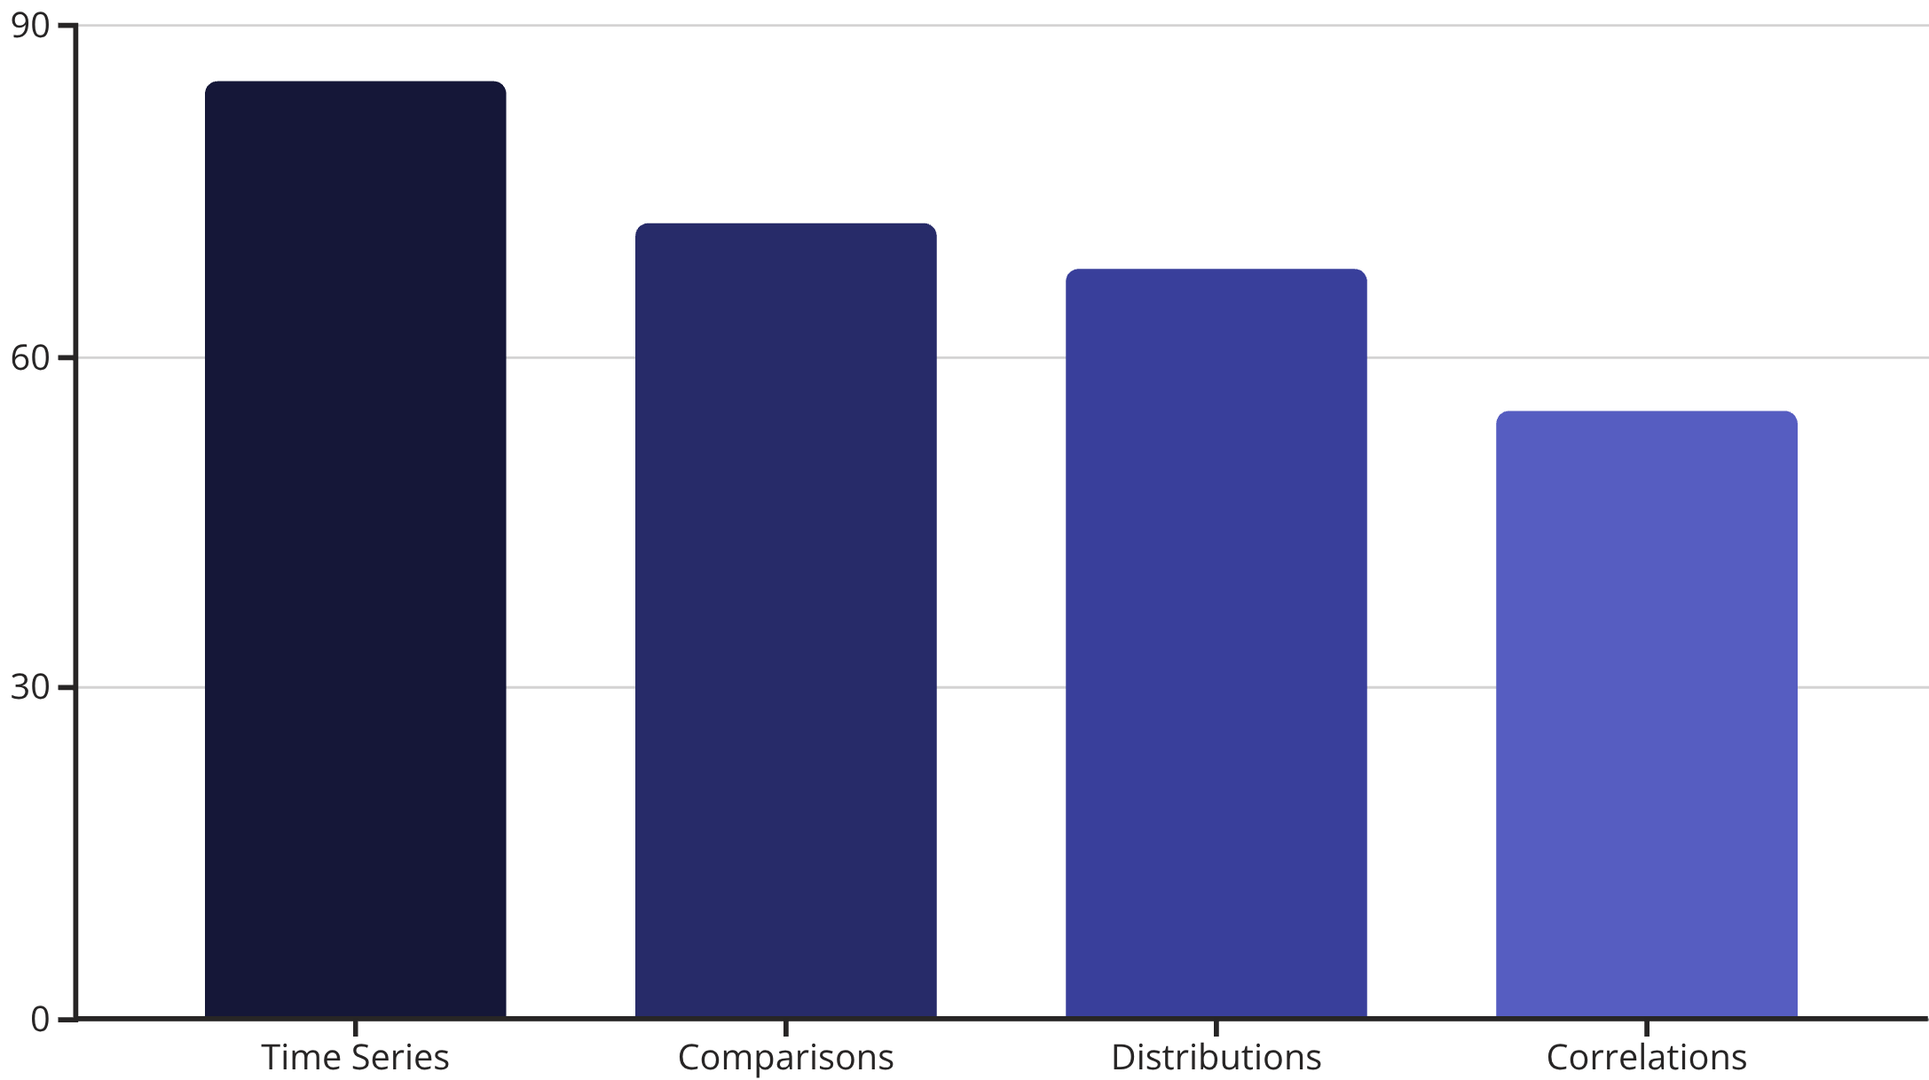
Data Visualization Prompts
Generate Visualization Code
Request Python matplotlib or seaborn code for specific chart types. Specify constraints like "no seaborn" or "separate subplots" for project requirements.
Get Chart Recommendations
Describe your data and analysis goal. The AI suggests optimal visualization types with explanations of why each is suitable for your specific use case.

Slide 10
The D.A.T.A Framework
A structured approach to crafting effective data and ML prompts that consistently deliver high-quality results.
Define Role
"You are a senior data analyst with 10 years of experience in retail analytics..."
Assign Task
"Perform exploratory data analysis and extract actionable insights from this sales dataset..."
Technical Constraints
"Return output in JSON format. Handle missing values as null. Use ISO date format..."
Actionable Output
"Provide specific business recommendations with expected impact and implementation steps..."

